Slide 1
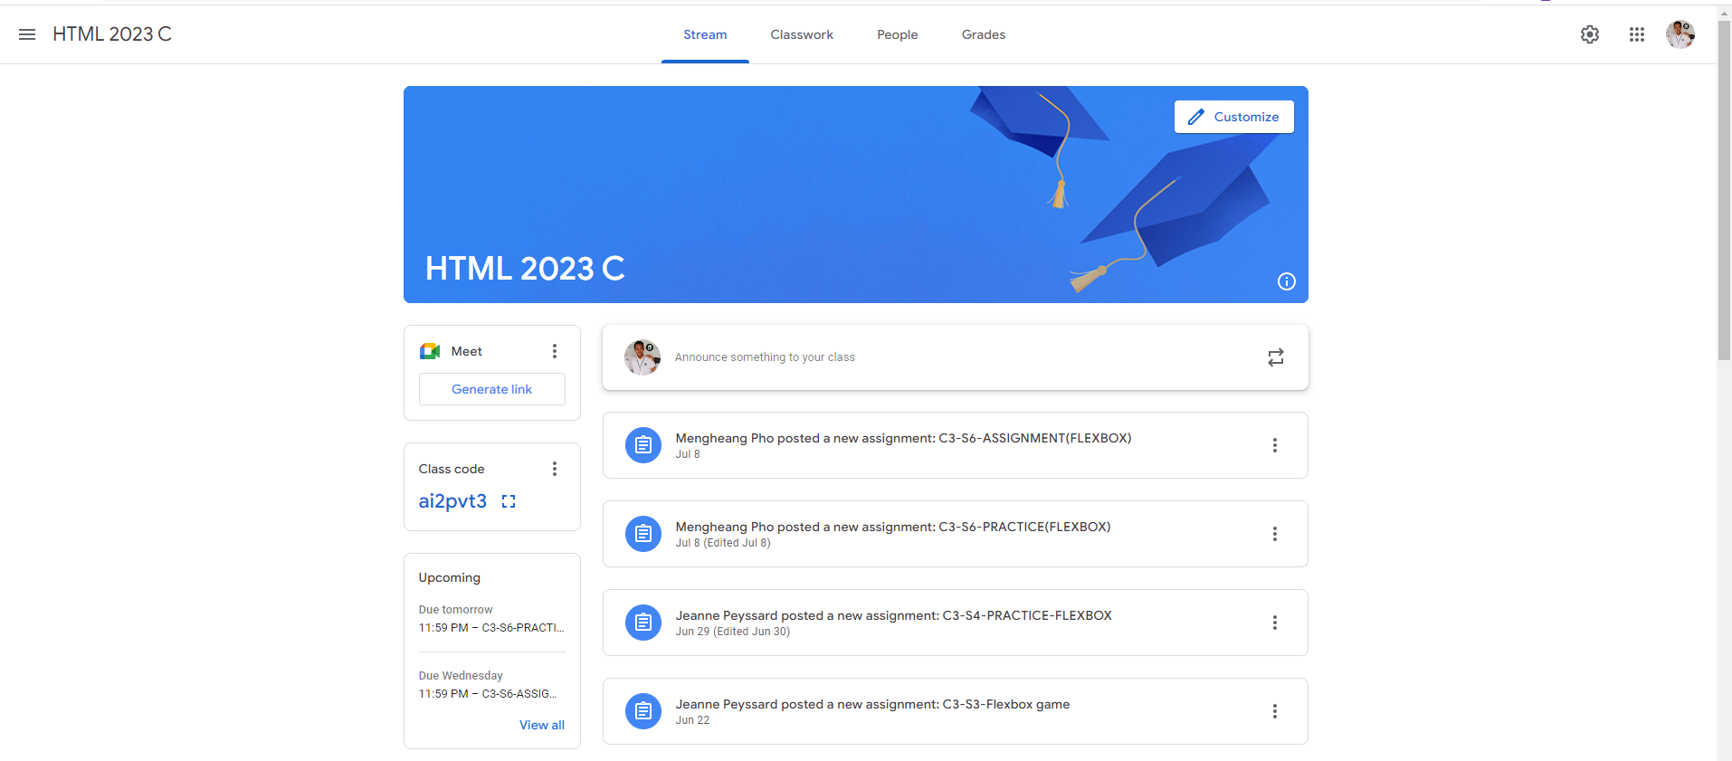
Identify root components of website below

Slide 2
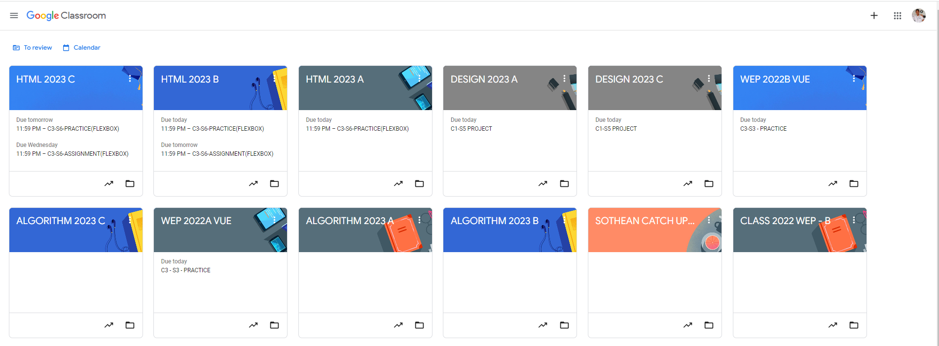
Root div
- Height: 100vh
content
nav
Flex: 0
header
Flex: 0
Flex: 1

Slide 3
Flex 0
Navigation Bar
main
Flex 1

Slide 4
elements
Space Between
elements
Space Between
elements

Slide 5

Col span 2
Flex 0
Main top
Flex 0
Flex 1
announcement
Right side
Left side
announcement
announcement
announcement
announcement

Slide 6
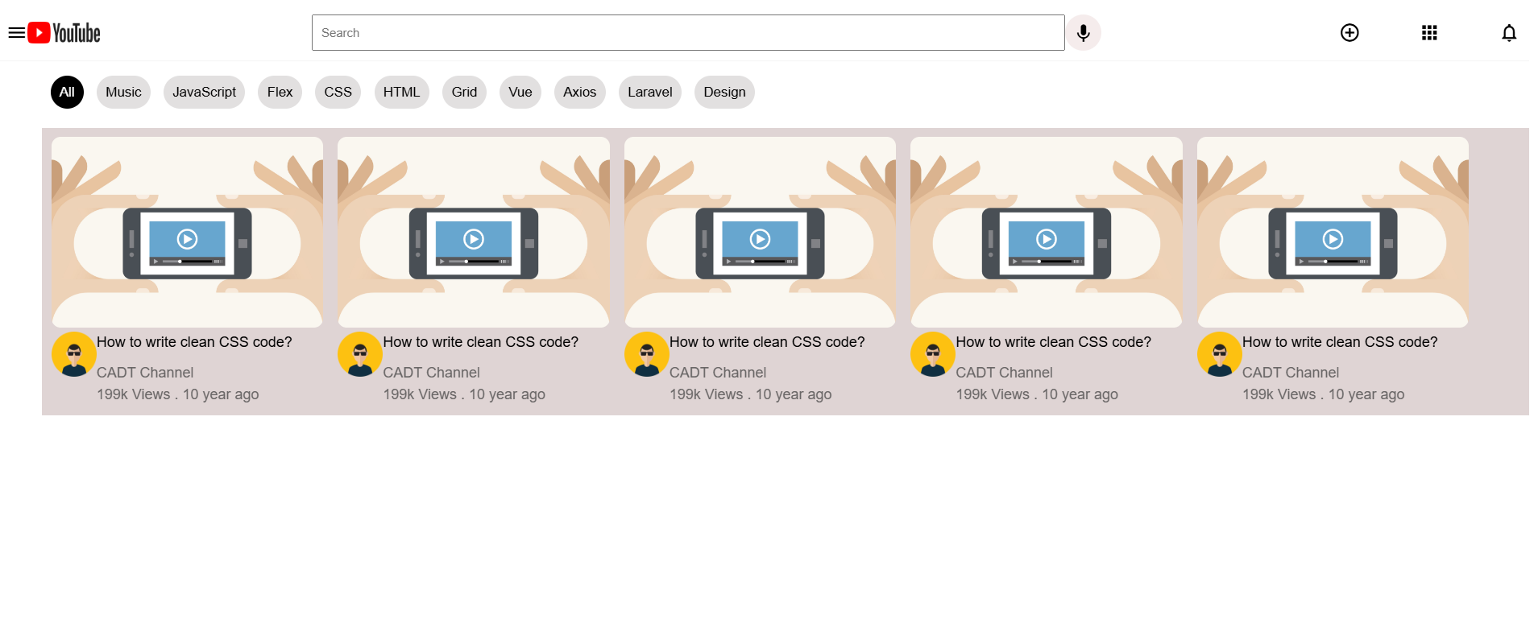

Slide 7
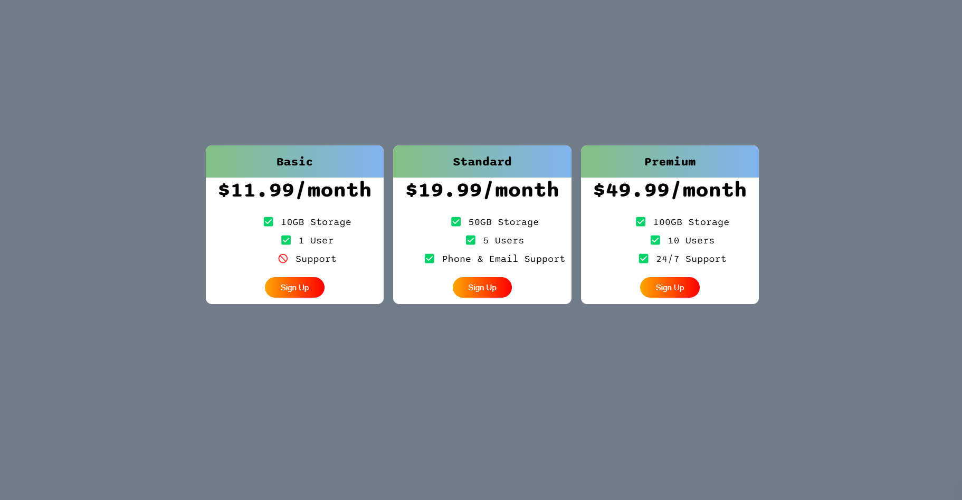

Slide 8
